Slide 1
PLASMA WELDING MACHINE

Slide 2
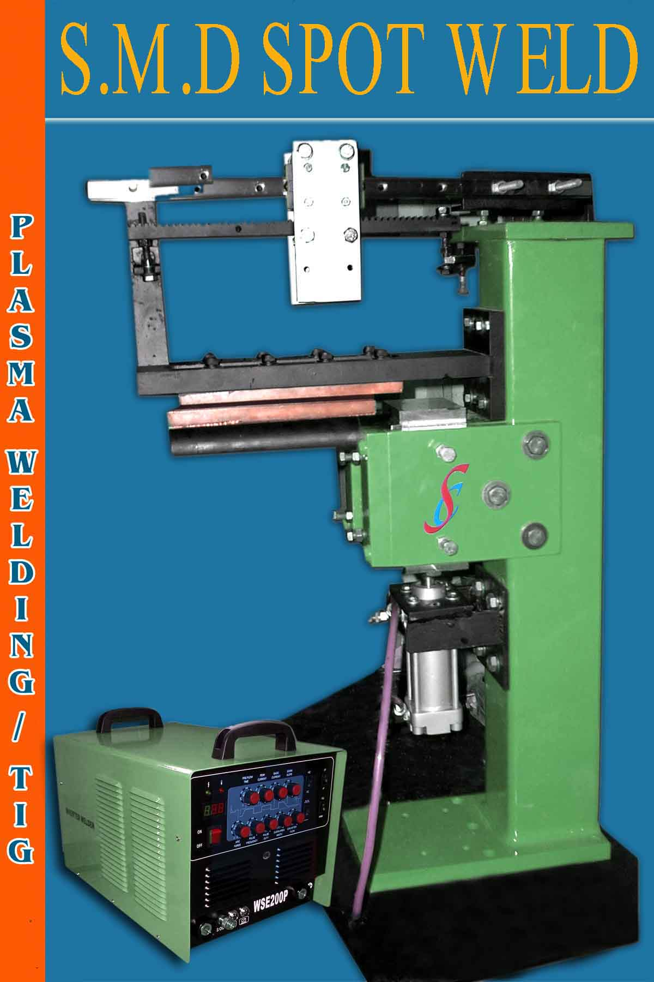

Slide 3
Linear Tig Welding SPM
JIG
Suitable for SS utensil butt joint (linear tig welding automation) also suitable for plasma welding
Welding Range : 0.3 to 2mm SS and MS
Input volt : 220 volt
With suitable tig power source
Manual foot operated automatic pneumatic operated also available PLC control
Torch moment control by DC motor with LM guide support

